Slide 1
SPEAKING: SHOPPING (WH QUESTIONS)
Do you enjoy shopping?
How often do you go shopping?
Where do you usually shop?
What’s the most expensive item that you’ve purchased?
(How can we do shopping): visit a store, go window-shopping, order online
(What do we shop): apparel, cosmetics, stationery, tech devices, groceries, accessories, etc
(Why do we go shopping): buy necessities, reduce stress, recreation, motivation, bargain hunting.
(What is shopping) online & offline

Slide 2
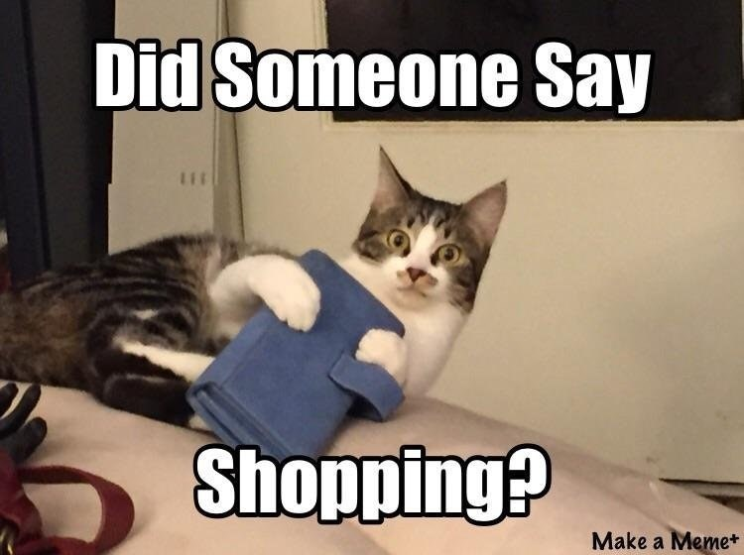
1. Do you enjoy shopping?
Answer: Yes, I truly take a keen interest in purchasing items
[what - specific]
whether they are just groceries for my family or technology devices.
[why]
This both helps me relax and feel more optimistic when the going gets tough.
[example]
Just yesterday I went to a Biti’s footwear store and bought a brand-new Air-Force 2020 sneaker to lift my moods after failing the math test.
Notes:
R & R = respite

Slide 3
2. How often do you go shopping?
Use adverbs of frequency (always, occasionally, never) and quantitative language (once a week, two times a month, once every two weeks).
Answer: I’d say I go out shopping very frequently, about 3 times a week.
[what]
I mostly look for discounted/clearance items to save up some money, like I did with the … which I just said earlier.
Also, about twice a week I also go window-shopping just to keep up with the latest tech advancement.
Notes:
Sau khi cho từng sample – cho học sinh nói

Slide 4
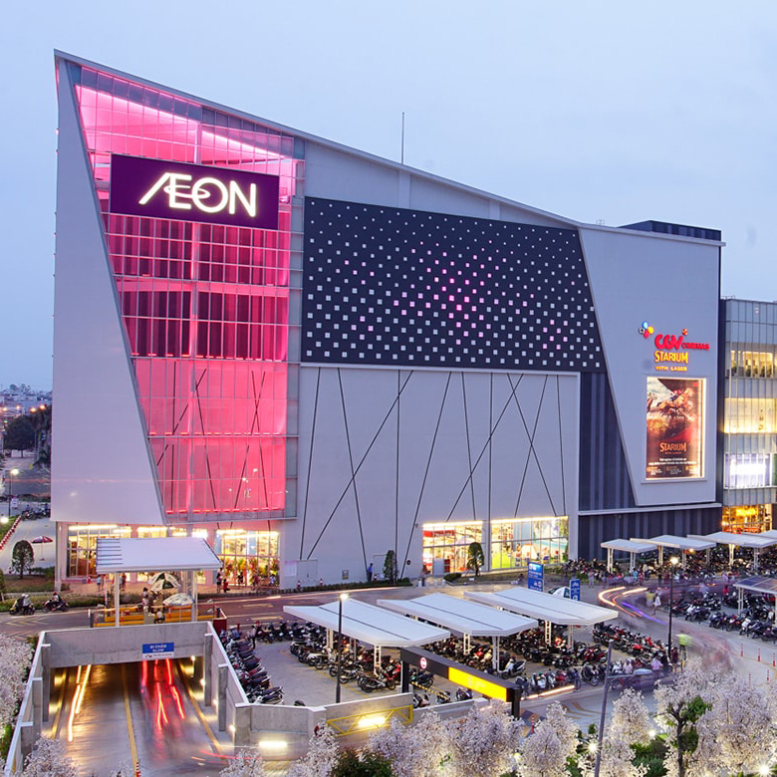
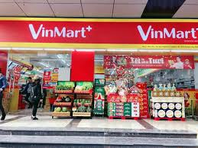
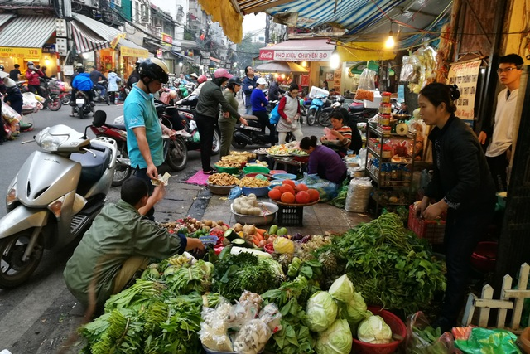

3. Where do you usually go shopping?
Notes:
Sau khi cho từng sample – cho học sinh nói

Slide 5
3. Where do you usually go shopping?
Answer_paraphrase:
To get groceries, I frequently head to a local flea market
(what does the place look like? why?)
where there are a bunch of vendors selling meat, veggies and other products.
(other places – optional)
But if I need to purchase clothing and merchandises, like batteries for my watch, then my go-to venue will be Vincom Mega Mall.
(example)
I just bought some beef at a butchers’ inside the market the other day to prepare my family some delicious steaks.
Notes:
Why: affordable – stock a wide range of items – express delivery – helpful staff – offer excellent customer service.

Slide 6
3. Where do you usually go shopping?
Answer:
Given the covid-19 pandemic, I’m finding myself regularly doing online shopping on Tiki, which is a Vietnamese major online retailer.
(what does it look like? Why)
The products there are reasonable and they also come with express delivery.
(example)
Last week I ordered the book: “Cambridge IELTS 13 Academic” to prepare for this exam.
Notes:
Why: affordable – stock a wide range of items – express delivery – helpful staff – offer excellent customer service.

Slide 7
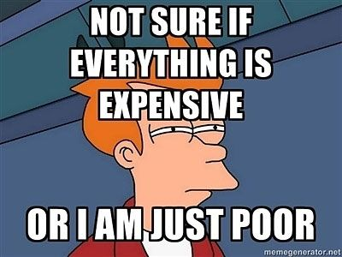
4. What’s the most expensive item that you’ve purchased?
Answer: The most expensive object which I’ve bought is my mobile phone, which is the Samsung Galaxy Note 10+ model.
[why]
I decided to make this purchase because 2 months ago my previous phone was out of order and I needed a replacement asap for my study.
[how much]
This new device cost me north of 1000 dollars. Fortunately, it was worth the price since all the features have been running fluidly.
Notes:
Remix, baroque, traditional, instrumental (violin, trumpet), rap

